Slide 1


VIVEKANANDA INSTITUE OF TECHNOLOGY (Affiliated to VTU and approved by AICTE) Gudimavu, Kumbalagodu post, Kengeri, off Mysore road Bengaluru-560074
DEPARTMENT OF CIVIL ENGINEERING
Internship Seminar Presentation
On
“CONSTRUCTION PRACTICES”
Presented By:
NANDISH U
1VK19CV403
VIII Sem
Department of Civil Engineering, VKIT
Guided By:
Mrs. PRATHEJA M
Assistant professor
Department of Civil Engineering, VKIT

Slide 2
CONTENTS
ABSTRACT
INTRODUCTION
ORGANIZATION OVERVIEW
WORK CARRIED OUT BY INTERN
CONCLUSION

Slide 3
ABSTRACT
This presentation consist of broad explanation about the works carried out in site.
The purpose of this course is to apply the theoretical knowledge into practical knowledge.
It gives the observation made during the one month of our study as a intern.
This study resolves around the materials used and the tests on each building components.
To understand the process of application, sustainable and construction methods.
In order to evaluate the feasibility of the material, the necessary test evaluation method is also learned.

Slide 4
INTRODUCTION
Civil engineering is a professional engineering discipline that deals with the design, construction, and maintenance of the physical and naturally built environment, including public works such as roads, bridges, canals, dams, airports, sewerage systems, pipelines, structural components of buildings, and railways.
As a site engineer he should have good analysis and decision power and should be able to solve engineering problems, by using mathematical modeling, scientific principles and laboratory techniques using computer and information technology.
As a intern it will make us familiar with proper planning, design and field operations.
To get exposure with the management and communication functions.
Getting knowledge about the Construction projects which are executed based on the drawing and specification.

Slide 5
ORGANIZATION OVERVIEW
COMPANY NAME | PRAGNA GROUP
TYPE | PRIVATE COMPANY
REGISTERED ADDRESS | #749, 3rd Floor, Opposite ICICI Bank, 7th Cross, 14th Main, BTM 2nd Stage, Bangalore-560076, Karnataka, INDIA
EMAIL ADDRESS | pragnagroups@gamil.com
STARTED | 2007
Pragana Group and its related companies pride themselves in developing and owning unique properties throughout Bangalore.
Over the past few years, the group has owned and developed more than a hundred acres of land, encompassing distinctive residential projects including gated communities and apartments.

Slide 6
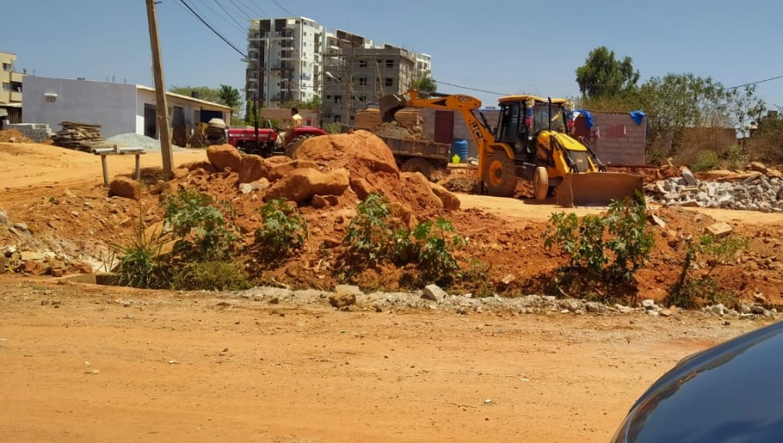
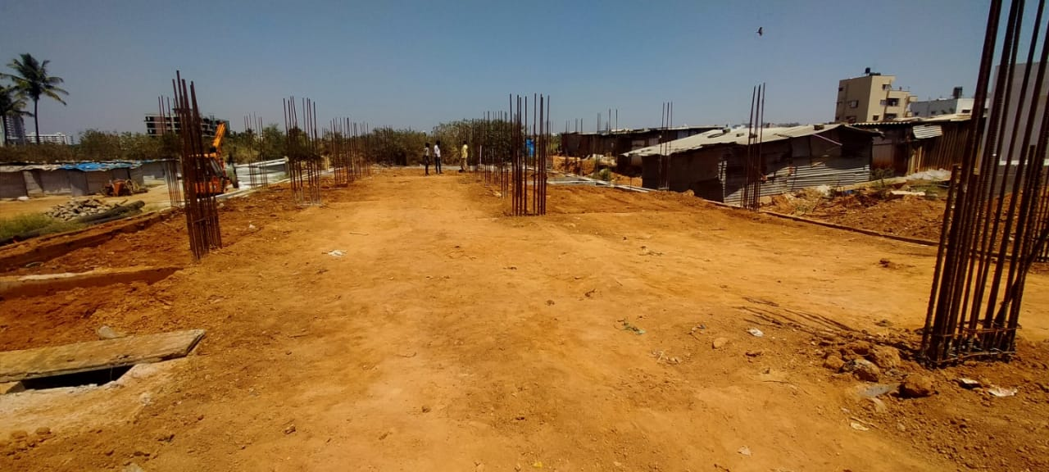
WORK CARRIED OUT BY INTERN
The site work I have been performed was controlling the work which is going on and supervising the work based on the given check list which was given to us from the office.
The checklist for site supervision is issued in order to ensure a uniform system of supervision of building construction projects and as a result ensure the quality of construction. In the checklist the responsibilities, liabilities and limitations of the supervisor are briefly mentioned in steps to the general terms.
EXCAVATION WORK
FILLING WORK

Slide 7
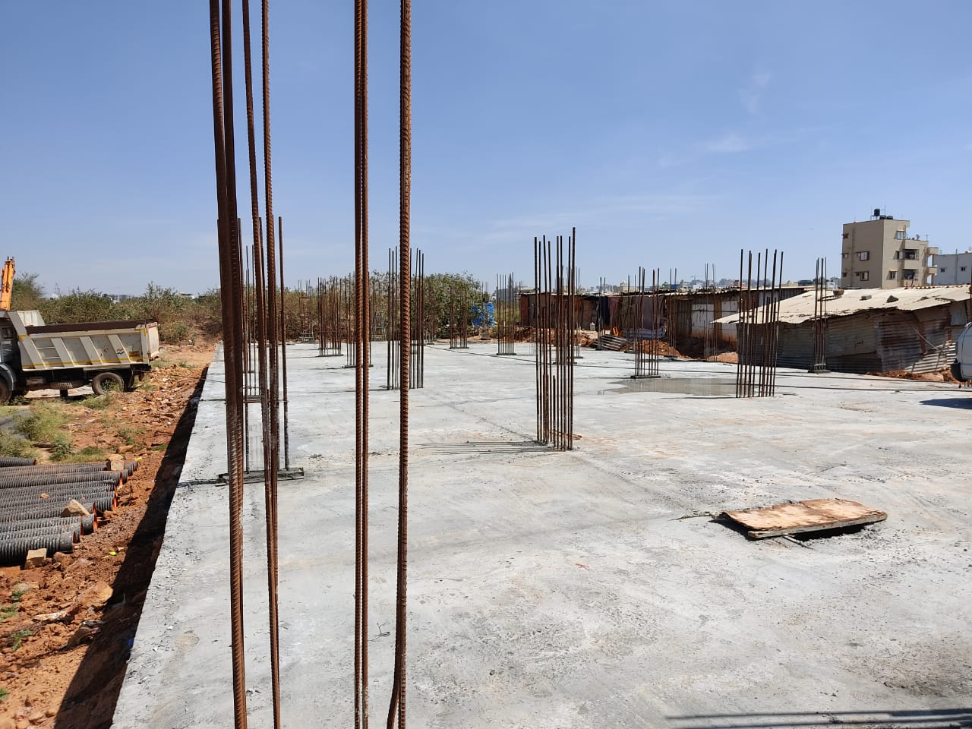
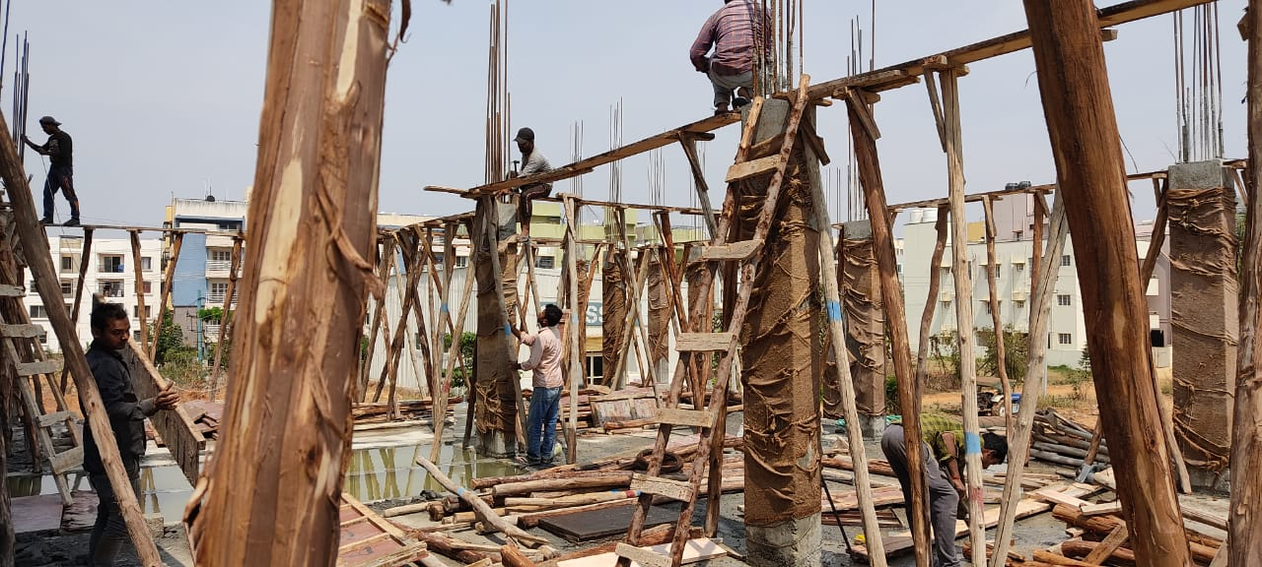
Continued..
PCC WORK
CONCRETE FORM WORK

Slide 8
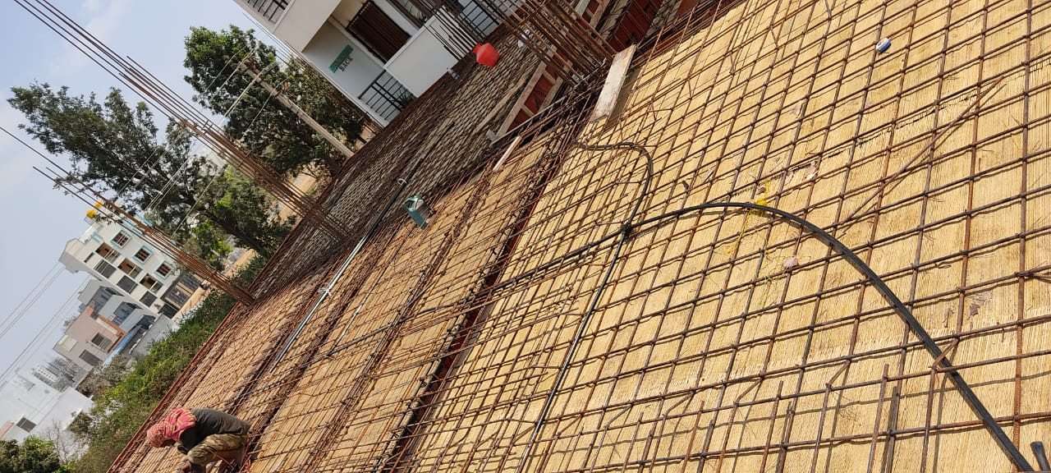
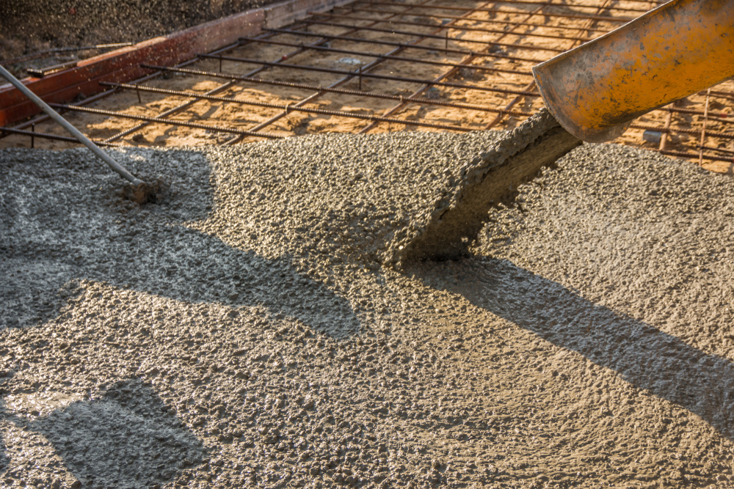
Continued..
REINFORCEMENT WORK FOR ROOF SLAB
POURING OF CONCRETE

Slide 9
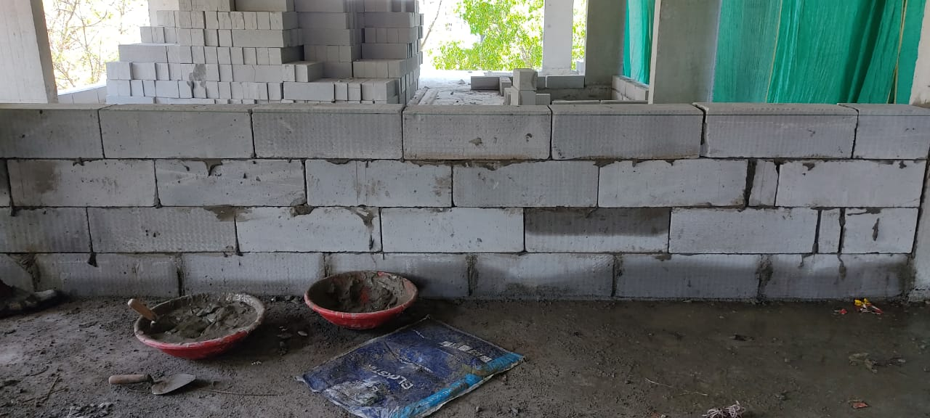
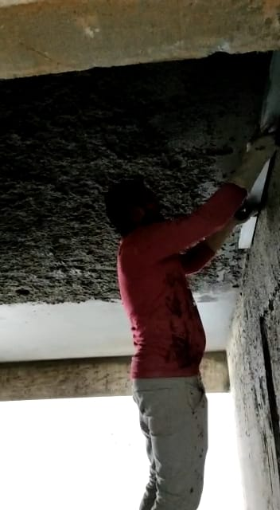
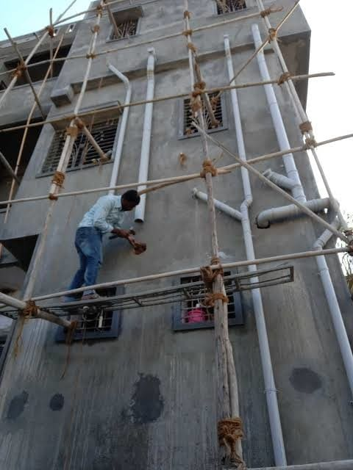
Continued..
MASONRY WORK
PLASTERING
26-05-2022

Slide 10
CONCLUSION
The benefit of internship is getting more practical knowledge about our field work.
The internship practice was held in site area and I got good opportunity to work in different aspects of construction work which was operated by PRAGANA GROUPS and gained practical knowledge about field work.
The core streams like civil engineering work have to be done in field in outside environment where the new peoples and new skills will be developed and also, we learn different type of forms and skills which will help us to do construction work easy and more economical.
We were able to acquire a high level of confidence to deal with problems that arise in a building construction.
The field work carried out at the construction site has benefitted me to manage things at pressure and apply theoretical knowledge practically through various activities and tasks given to me.

